Slide 1
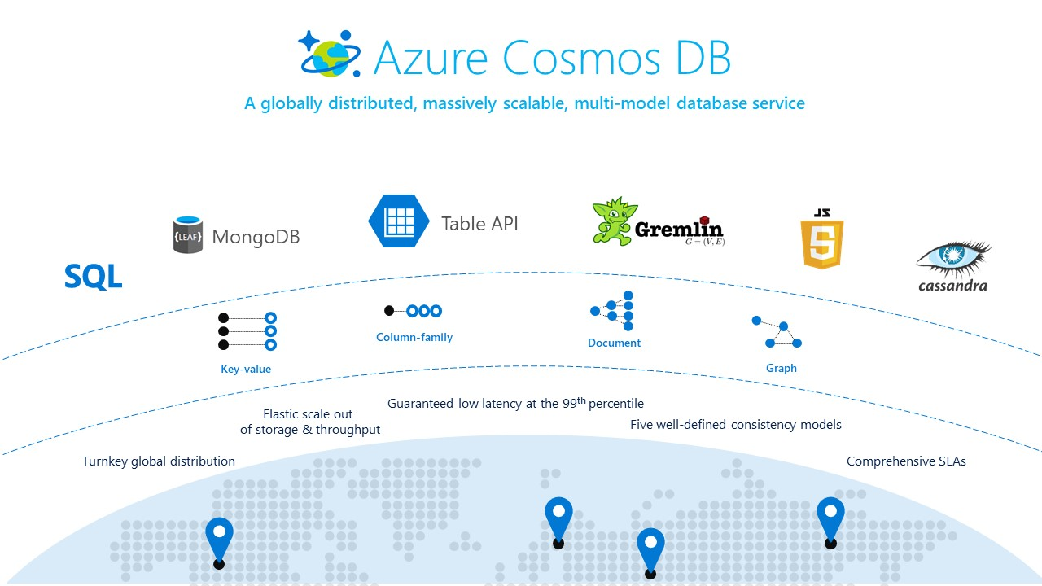
Azure Cosmos DB
Nagesh Sathrasala

Slide 2

About Your Instructor
Nagesh Sathrasala
Database developer.
Database administrator.
Database and Cloud Architect.

Slide 3
Overview
What is NoSQL?
Why NoSQL?
Evolution of CosmosDB

Slide 4










What is NoSQL and Why NoSQL?
`
Notes:
1. Document based (Mongo DB, Couch base).
2. Key value based (Redis, Memcached).
3. Graph databases (Apache Tinker POP (Gremlin API)).
4. Columnar (Cassandra, HBASE)).
5. Multi-model databases like Cosmos DB and so on.

Slide 5



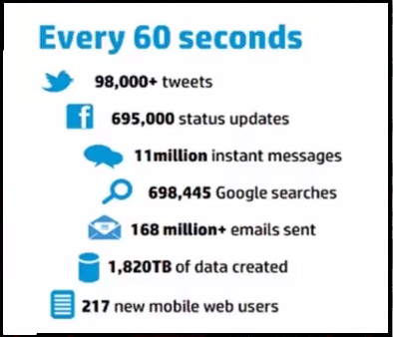
3 Vs of Big Data
Volume
Verity
Velocity
5

Slide 6
Why NoSQL?
Draw backs in Traditional relational Databases:
Predefined Schema which cannot be changed on the fly.
It is not possible for RDBMS to process unpredictable and unstructured information.
Normalized data slow in processing huge amount of data.
Only Vertical growth is allowed but not horizontal.
Distribution is not allowed.
All above problems are resolved with help of NoSQL DB’s.
Distributed replicas. (HA and Throughput)
Scale-out (Horizontal partitioning)
Schema-free (Document, table, graph and columnar models)

Slide 7
Definition of CosmosDB
Azure Cosmos DB is a schema-free database system designed for low-latency, high throughput, globally distributed, a multi-model database with turn-key scaling, Highly available with best in class SLA's and offers 5 consistency options to let you handle how to deal with the CAP theorem.

Slide 8
Evolution of CosmosDB
2010-2014
Internal Microsoft Document DB Service
Office, OneNote, Xbox
Aug 21, 2014
Azure Document DB preview
Apr 8, 2015
Azure Document DB GA (General Availability)
New features
Mar 31,2016
Tunable throughput, indexing, consistency
Server-side ACID transactions
Runs on Azure (fully managed PaaS)
SQL like quires over schema-free JSON
Aug 2015
ORDER BY and string range queries
Geospatial support, SDK partitioning support
Partitioned collections, Geo-replication
New features
Support for MongoDB (BSON)

Slide 9
Evolution of CosmosDB
May 10, 2017
Azure Cosmos DB
Turnkey global distribution Horizontal partitioning
2018
New features
Low latency (single-digit millisecond) SLAs for guarantees on 99.99%
Availability, throughput, latency, and consistency
Reserved Capacity.
Cosmos Explorer.
99.999% write availability, all around the world.
Sharing provisioned throughput across multiple containers
Multi master and conflict resolution.
Columnar (Cassandra API)
JSON (SQL API) BSON (MongoDB API)
Graph (Gremlin API) Key-value (Table API)
Local emulator Multi-model, multi-API database
Reserved Capacity helps you save up to 65%
JavaScript SDK V2

Slide 10






Azure Cosmos DB
A globally distributed, massively scalable, multi-model database service
Table API
Future APIs
MongoDB
Column-family
Document
Key-value
Graph
Elastic scale out
of storage & throughput
Guaranteed low latency at the 99th percentile
Five well-defined consistency models
Turnkey global distribution
Comprehensive SLAs

Slide 11
CosmosDB Key capabilities
Turnkey Global Distribution with Multi master capabilities.
Multiple Data Models and popular API’s.
Elastically and independently scale throughput and storage .
Build highly responsive and mission critical applications.
SLA backed availability, throughput and consistence.
Write globally distributed application with 5 consistence models.
Best Industry SLA’s
Low cost.
Numerous features for free
Deep integration of Azure Cosmos DB with other Azure service
Save costs with Reserved Capacity.

Slide 12

Architecture of CosmosDB
Document
SQL API(JSON)
Mongodb API (BSON)
Key-Value
Table API
(Replacement of Azure Table Storage)
Graph
Gremlin API
Columnar
Cassandra API
ARS (Atom, Record, Sequence)

Slide 13
Database engine
Resource Manager
RSM
Language Runtime(s) Hosts
Index Manager
Storage Engine
Log Manager
Query Processor
IO Manager

Slide 14
Demos
Creating Azure resource and Cosmos DB account.
Local Emulator, how to install and use.
Creating Collections and documents
Notes:
Emulator: https://docs.microsoft.com/en-us/azure/cosmos-db/local-emulator
To generate demo data: https://www.generatedata.com/
Try cosmos DB for a month: aka.ms/trycosmosdb

Slide 15
Performance and Throughput
How to measure Performance and What is RU
Latency
Latency about how quickly you receive response for your request.
Throughput
About how many concurrent requests you can process within given period.
% Memory
% CPU
% IOPS
Notes:
In short if we want to define RU, to process 1KB document from a single partition with the help of CPU, Memory and IO is known as RU.

Slide 16
Performance and Throughput
Request Units
1 read of 1 KB document from a single partition
Each request consumes fixed RUs
Applies to reads, writes, query, and stored procedures
GET
=
POST
=
PUT
=
Query
=

Slide 17
Performance and Throughput
Important Characteristics to know about RU’s
RU’s are calculated per 1 KB
CosmosDB is very transparent on Usage of RU’s.
Document size, complexity, Indexing policy, consistency level and predicates will define RU’s use.
RU’s are deterministic.
Flexibility to setup RU Threshold.
Request Throttling.
Notes:
Refused request response header. HTTP Status 429

Slide 18
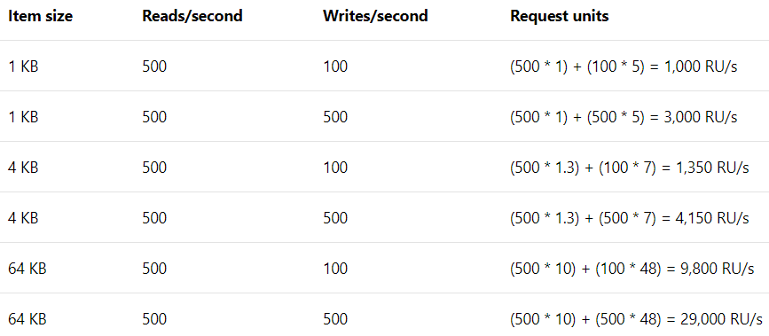
Performance and Throughput
How to calculate RU’s
Application checklist
What does a typical item look like?
What are the typical queries that users will run?
How many writes per second are required?
How many queries per second are required?
What is the acceptable consistency level?
What is the indexing policy?
* Based on Session consistency indexing policy set to None.

Slide 19
Performance and Throughput
How to Calculate RU’s and Pricing
SSD Storage
Consumption based $0.25 per GB per month
Throughput
Reserved RU/Sec per hour
$0.008 for 100 RU/Sec
Minimum allowed id 400 RU/Sec

Slide 20
Demos
How to Measure Required RU’s.
Monitoring RU consumption and Alerts.
Allocating RU’s at both Database Collection level.
Notes:
https://www.documentdb.com/capacityplanner
To generate demo data: https://www.generatedata.com/

Slide 21
Horizontal Partitioning and backup recovery
What we will cover
What is Partitioning.
Key point to note regarding Partitions
Best practices and benefits of partition.
Modeling your data for better partitioning and performance.
Cross partition Queries and how to work with them.
Automatic backup restore with Azure DB.

Slide 22
Horizontal Partitioning and backup recovery
What is Partitioning.
Partition
Physical Fixed-capacity data store.
Massive Scale out within a Container.
Unlimited Auto scaled Containers
Logical Partition
Physical Partition
Container
Partition
Partition
Partition
Partition
Pt1
Pt1
Pt2
Pt2
Pt1
Pt2

Slide 23
Horizontal Partitioning and backup recovery
Partitioning in CosmosDB
Partition Key: User ID
Cosmos DB Collection
Logical Partitioning
Physical Partitions
hash(User ID)
Pseudo-random distribution of data over range of possible hashed values

Slide 24
Horizontal Partitioning and backup recovery
Key point to note regarding Partitions
Unlimited number of partitions.
Partition size limits.
Immutable Partition Key.
Auto Management of partitions.
What is hot partition.
Relationship between logical and physical partitions.

Slide 25
Horizontal Partitioning and backup recovery
Best practices
Benefits
Distribute requests.
Distribute storage.
Understand your application.
Understand top 5 quires.
Use Synthetic Key.
Build POC.
Too many partition Keys are fine.
Faster retrieval of data.
ACID properties can be achieved.
Server side coding is possible.
Multi-record transactions.
Unlimited growth of your database.

Slide 26
Horizontal Partitioning and backup recovery
Cross partition Queries and how to work with them.
Queries
Typically scoped to a
single partition key
Stored Procedures
Always scoped to a
single partition key
Cross-Partition
Queries
Span multiple
partition keys
Fan-out execution
Notes:
FeedOptions.setEnableCrossPartitionQuery

Slide 27
Horizontal Partitioning and backup recovery
Modeling your data for better partitioning and performance.
When to denormalized
When to separate data
Data from entities are queried together
Child data is dependent on a parent
1:1 relationship
Similar rate of updates – does the data change at the same pace
1:few – the set of values is bounded
Better read and plan your writes.
1 : many (unbounded relationship)
many : many relationships
Data changes at different rates
Better Write, poor read.

Slide 28
Horizontal Partitioning and backup recovery
Synthetic Key or Composite Partition Key
{ "deviceId": "abc-123", "date": 2018 }
{ "deviceId": "abc-123", "date": 2018, "partitionKey": "abc-123-2018" }

Slide 29
Horizontal Partitioning and backup recovery
Sample Scenarios
Car Telemetric information:
Vehicle Model
Current Date
Device Id
Composite Key – Device ID + Current Date
Online Shopping:
Customer ID
Current Date
ZipCode
Composite Key – ZipCode + Current Date

Slide 30
Automatic backup restore with Azure DB.
Every 4 hours backups
Backup to blob and replicates.
RU’s for Backup
How to restore deleted containers.
How to restore Cosmos DB account.

Slide 31
Demos
How to setup Partitioning.
How to work with cross partition quires.

Slide 32
Data distribution
What we will cover
Introduction to data distribution.
How Replications works.
Key benefits and use cases.
Different options available and failover properties.

Slide 33
Data distribution
Introduction to data distribution.
Availability
Increased SLA’s
Performance

Slide 34
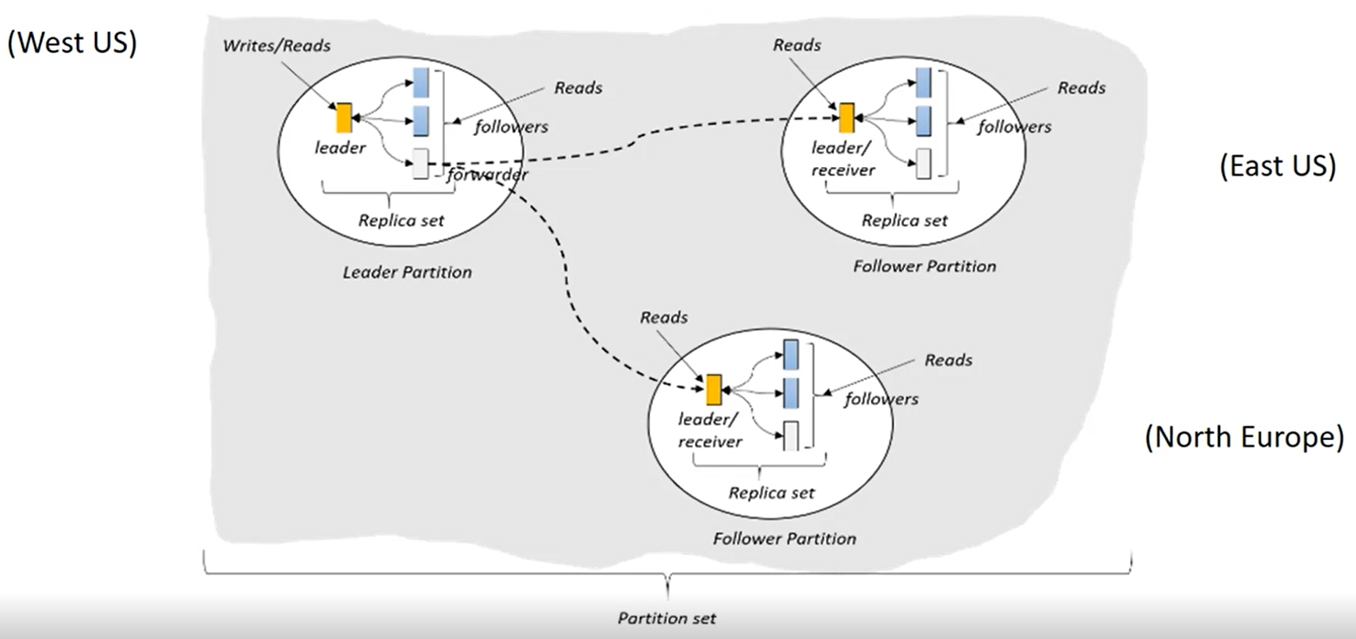
Data distribution
How replication works

Slide 35
Data distribution
Key benefits and use cases.
Key benefits
Single digit latency
5 9’s availability
Flexible conflict resolution
Use Cases
Social Media apps
IoT
E-commerce
Metering and so on.

Slide 36
Data distribution
Different options available and failover properties.
Trunkey Global Distribution.
Multi-master and conflict resolution.
Last-writer-wins (LWW)
Custom – User-Defined Procedure
Custom – Asynchronous
Dynamically add and remove regions.
Multi-homing API.
Failover priorities.
Auto recovery of replication.

Slide 37
Demos
Setting up Geo replication.
Setting up failover priorities.
Manual Failover.
How set failover preferences in your application.

Slide 38
Consistency levels.
What we will cover
Consistency Models.
Scope of Consistency models.
Tunable consistency Models.
Demo: how to switch between Consistency level.

Slide 39
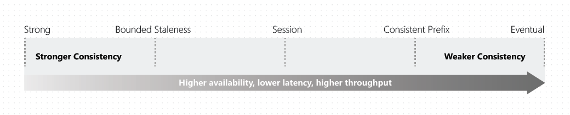
Consistency levels.
How do you ensure consistent reads across replicas?
Replication within a region
- Data moves extremely fast (typically, within 1ms) between neighboring racks
Global replication
- It takes hundreds of milliseconds to move data across continents

Slide 40
Consistence levels.
Tunable consistency Models.
Consistency Level | Guarantees | Dirty Reads
Strong | Linearizability. (Once operations completes, it will be visible to all) | No Dirty reads.
Bounded Staleness | Consistent Prefix. Reads lag behind writes by at most k prefixes or t interval | Dirty possible bounded by time and updates.
Session | Consistent Prefix. Monotonic reads, monotonic writes, read-your-writes, write-follows-reads | No dirty reads for writers Dirty reads possible for other users
Consistent Prefix | Reads will never see out of order writes (no gaps) | Dirty reads possible
Eventual | Potential for out of order reads. Lowes cost for reads of all consistency levels. | Stale reads possible No guaranteed order
Notes:
10 to 10,00,000 operation or 5 sec to 1-day delay within the region.
1,00,000 to 10,00,000 operations or 5 minutes to 1 day when data is replicated across the regions.

Slide 41
Demos
How to switch between Consistence level in portal.

Slide 42
SQL API
What we will cover
Document Database
Difference between relational and Document DB
Cosmos DB Hierarchical resource model.
Recourse Prosperities, Self-Link and URI.
SQL Operators and functions.
Data migration and Demo.
Demo Querying collections

Slide 43
SQL API
Document Database
Semi-structured JSON
(JavaScript Object
Notation) documents
Two API
1) SQL API
2) MongoDB API

Slide 44
SQL API
Difference between relational and Document DB
Relational Database | Document database
Rows | Documents
Document 1
{ data }
Table
Data
Data
Data
…
Document 2
{ data }
Row 1
Row 2
Row 3
…
Document 3
{ data }

Slide 45
SQL API
Difference between relational and Document DB
Relational Database | Document database
Rows | Documents
Columns | Properties
Col1 | Col2 | Col2 | Col2
Data | Data | Data | Data
Data | Data | Data | Data
Data | Data | Data | Data
Data | Data | Data | Data
Document 1
{ "prop1": data, "prop2": data, "prop3": data, "prop4": data }
Document 2
{ "prop1": data, "prop2": data, "prop3": data, "prop4": data }
Document 3
{ "prop1": data, "prop2": data, "prop3": data, "prop4": data }

Slide 46
SQL API
Difference between relational and Document DB
Relational Database | Document database
Rows | Documents
Columns | Properties
Predefined and strongly typed schema | Schema free
ID | Name | IsActive | Dob
1 | Black Smith | True | 8/25/1974
2 | Steve Jones | False | 2/15/2001
3 | Adam Clark | True | 7/16/1983
Document 1
{ "id": 1, "name": “Black Smith", "isActive": true, "dob": "1974-25-08" }
Document 2
{ "id": 2, "fullName": "Steve Jones", "dob": "2001-02-15" }
Document 3
{ "id": 3, “fullName": { "first": "Adam", "last": "Clark" }, "isActive": true, "dob": “1983-07-16" }

Slide 47
SQL API
Difference between relational and Document DB
Relational Database | Document database
Rows | Documents
Columns | Properties
Predefined and strongly typed schema | Schema free
Normalized | Typically deformalized
User Table
Document
{ "id": 1, "name": “Black Smith", "dob": "1974-30-08", "holdings": [ { "qty": 100, "symbol": “JSW" }, { "qty": 75, "symbol": “RIL" } ] }
ID | Name | IsActive | Dob
1 | Black Smith | True | 8/30/1974
Holdings Table
StockID | UserID | Qty | Symbol
1 | 1 | 100 | JSW
2 | 1 | 150 | RIL

Slide 48
Relational Vs NoSQL (non relational)
Menu Item
------------
ID
Item Name
Item Description
Item Category ID
Category
------------
ID
Category Name
Category Description
Relational modelling – Each menu item has a reference to a category.
{
"ID": 1,
"ItemName": "hamburger",
"ItemDescription": "cheeseburger, no cheese",
“CategoryId": 5,
"Category": "sandwiches"
"CategoryDescription": "2 pieces of bread + filling"
}
Non-relational modeling – each menu item is a self-contained document

Slide 49
Cosmos DB Hierarchical resource model.
Resource Model URI and Credentials
Account
********.azure.com
Database
Database
Database
C2y6yDjf …
Database
Database
Container
Database
Database
Item

Slide 50
Cosmos DB Hierarchical resource model.
Database Representations
Account
Database
Database
Database
Database
Database
=
Database
Database
Container
Container
Collection
Graph
Table
Database
Database
Database
Database
Item
Item

Slide 51
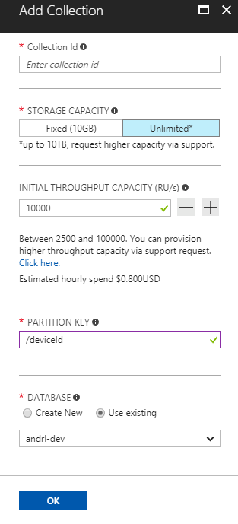
Cosmos DB Hierarchical resource model.
Creating Collections – SQL API
Account
Database
Database
Database
Database
Database
Container
Database
Database
Item

Slide 52
Cosmos DB Hierarchical resource model.
Container-Level Resources
Account
Database
Database
Database
Database
Database
Container
Database
Database
Sproc
Trigger
UDF
Conflict
Item

Slide 53
SQL API
Recourse Prosperities, Self-Link and URI.
Every Resource contains these properties
Property | Value
Id | User-defined unique ID (string)
_rid | Resource ID
_ts | Timestamp (last updated) epoch value
_etag | Binary value Used for optimistic concurrency
_self | URI path to the resource
_attachments | URI path suffix to the resource attachments

Slide 54
SQL API
Data migration Tool and Demo.
Data migration tool link.
Documentation and how to.
Source code on Git-hub
Import from:
SQL Server
JSON
CSV
MongoDB
Azure table
DynomoDB
Hbase
DcoumentDB
Export to:
JSON
DocumentDB

Slide 55
SQL API
SQL Operators and functions.
Common operators
Built-in functions
ABS, CEILING, EXP, FLOOR, LOG, LOG10,POWER, ROUND,SIGN, SQRT, SQUARE, TRUNC, ACOS, ASIN, ATAN, ATN2,COS, COT, DEGREES, PI, TAN RADIANS, SIN
Mathematical
Arithmetic
+ - * / %
Bitwise
| & ^ < >> >>>
IS_ARRAY, IS_BOOL, IS_NULL, IS_NUMBER, IS_OBJECT,IS_STRING,IS_DEFINED, IS_PRIMITIVE
Type Checking
Logical
AND, OR
String Functions
CONCAT, CONTAINS, ENDSWITH, INDEX_OF, LEFT,LENGTH, LOWER, LTRIM, REPLACE, REPLICATE, REVERSE, RIGHT, RTRIM, UPPER, STARTSWITH, SUBSTRING, ToString, TRIM
Comparison
= <> > >= < <=
Coalesce
? : ??
Array Functions
ARRAY_CONCAT, ARRAY_CONTAINS, ARRAY_LENGTH, ARRAY_SLICE
String
|| (concatenate)
Aggregate
COUNT, SUM, MIN, MAX, AVG
Spatial
ST_DISTANCE, ST_WITHIN, ST_INTERSECTS, ST_ISVALIDDETAILED

Slide 56
Demos
Importing data from SQL Server using Data migration tool.
Scaler expression quires.

Slide 57
Demos
Querying Documents in a Collection
Querying all Documents in a collection
Selecting particular columns and formatting. (including usage of value)
Querying sub documents and arrays.
Using from with in.
Joining Sub documents and arrays. (single and multiple joins)
Using Construct (Coalesce) within select.
String concatenation and Range queries and Sort. (difference ways of using between)
Boolean expression (on = comparison).
How to use IIF (Ternary ?) operator.
Using Aggregate functions.

Slide 58
Programming with .NET SDK
What we will cover
Introduction.
Working with .Net SDK for SQL API.
Demos.

Slide 59
Programming with .NET SDK
Introduction
Build Applications
Uses REST/HTTP
SDKs
.NET / .NET Core
Java
Node.js
Python

Slide 60
Programming with .NET SDK
Working with .Net SDK for SQL API
Three easy steps to start working with .NET SDK
Invoke methods to access resources
Create, modify, and delete resources
Task Parallel Library (TPL)
Simplified asynchronous programming
Use async/await wait keywords with Task objects

Slide 61
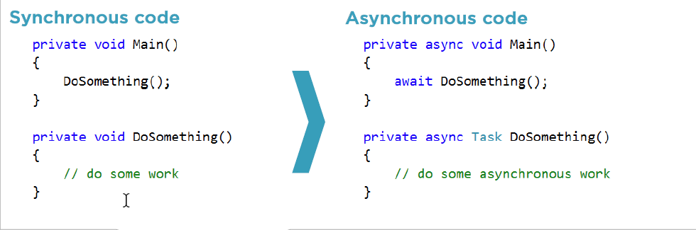
Programming with .NET SDK
Working with .Net SDK for SQL API
Create a DocumentClient instance
Supply connection information
(endpoint and key)
Invoke methods to access resources
Create, modify, and delete resources
Use POCOs or dynamics for document objects
Task Parallel Library (TPL)
Simplified asynchronous programming
Use async/await wait keywords with Task objects

Slide 62
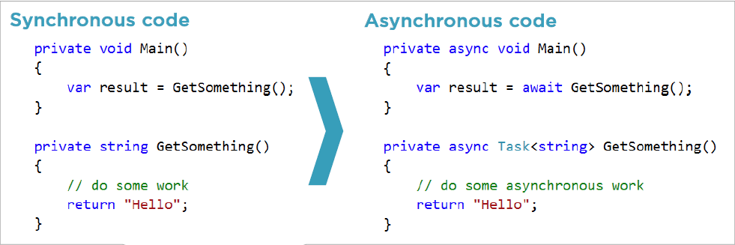
Programming with .NET SDK
Working with .Net SDK for SQL API
Create a DocumentClient instance
Supply connection information
(endpoint and key)
Invoke methods to access resources
Create, modify, and delete resources
Use POCOs or dynamics for document objects
Task Parallel Library (TPL)
Simplified asynchronous programming
Use async/await wait keywords with Task objects

Slide 63
Programming with .NET SDK
Working with .Net SDK for SQL API
Create a Document Client instance
Supply connection information
(endpoint and master key)
Invoke methods to access resources
Create, modify, and delete resources
Task Parallel Library (TPL)
Simplified asynchronous programming
Use async/await wait keywords with Task objects
LINQ provider
Automatically translates LINQ queries to SQL

Slide 64
Demos
Getting Started with .NET SDK
Working with Databases.
Working with Collections.
Working with documents.

Slide 65
Indexing in Cosmos Database.
What we will cover
Introduction
Indexing Policies and Index management
Demos.

Slide 66
Indexing in Cosmos Database.
Introduction
Key benefits of indexes
Hash Index
Good for equality queries of strings and numbers
Range Index
Good for Equality, Range, order by of strings and numbers.
Spatial Index
Used with Distance and intersection points, polygons and line strings

Slide 67
Indexing in Cosmos Database.
Indexing Policies and Index management
Collection-wide policy
Established when creating a collection
Can be changed after collection is created
Automatic indexing
Manual Indexing
Can override at document level
Custom indexing
Include/exclude selected property or paths
Individual properties (?) Recursive properties (*)
/name/? /address/*
/address/state/? /item/colors[]/*

Slide 68
Indexing in Cosmos Database.
Indexing Policies and Index management
Collection-wide policy
Established when creating a collection
Can be changed after collection is created
Automatic indexing
Manual Indexing
Can override at document level
Custom indexing
Include/exclude selected property or paths
Indexing modes
Consistent (synchronous)
Lazy (asynchronous)

Slide 69
Demos
Disabling of indexing while inserting a document.
Custom indexing paths.

Slide 70
Users and permissions
Users and permissions
Resource tokens vs. master key.
Create database users.
Get resource token from permission.
Connect using resource tokens.

Slide 71
Demos
Working with User permissions.

Slide 72
Stored procedures, Functions and Triggers
What we will cover
Introduction
Benefits of server side code.
Demo: Stored procedures.
Demo: Function.
Demo: Triggers.

Slide 73
Stored procedures, Functions and Triggers
Introduction
Run code inside Cosmos DB
Stored procedures
Triggers
User-defined functions
Scoped by partition key
Read/write documents within partition key
Fully transactional (ACID)
Bounded execution
Implement continuation model
for long running processes
Handle throttling (code 429)
Implement retry logic

Slide 74
Stored procedures, Functions and Triggers
Benefits of server side code.
Full ACID support.
Server side execution of code.
Re-usable custom logic.
Faster bulk operations.

Slide 75
Stored procedures, Functions and Triggers
Writing Server Side Code
Write a Java Script function.
Obtain context object
Context object exposes you to:
Collection.
Request.
Response.
Notes:
Server side code runs on server side that makes debugging server side more complex than code written .NET SDK.

Slide 76
Demos
Creating Stored procedures
Document validation and manipulation Stored procedure.
Bulk Insert Stored procedure
Bulk delete stored procedure

Slide 77
Working with Triggers
What we will cover
Attach custom behavior
Access document being
created or replaced
Two trigger types
Pre-trigger
Post-trigger
Not fired automatically
Must be explicitly requested with an operation

Slide 78
Demos
Creating Triggers
Pre-triggers
Post-triggers

Slide 79
Working with Functions
What we will cover
Extend the query language
Write custom business logic that can be called from inside queries
Use with care
Querying on a UDF requires a scan (cannot use index)
No access to context
Compute-only
JavaScript

Slide 80
Demos
User-Defined Functions (UDFs)

Slide 81
TTL and Change Feed
Container Level
Document Level.
Uses _ts.

Slide 82
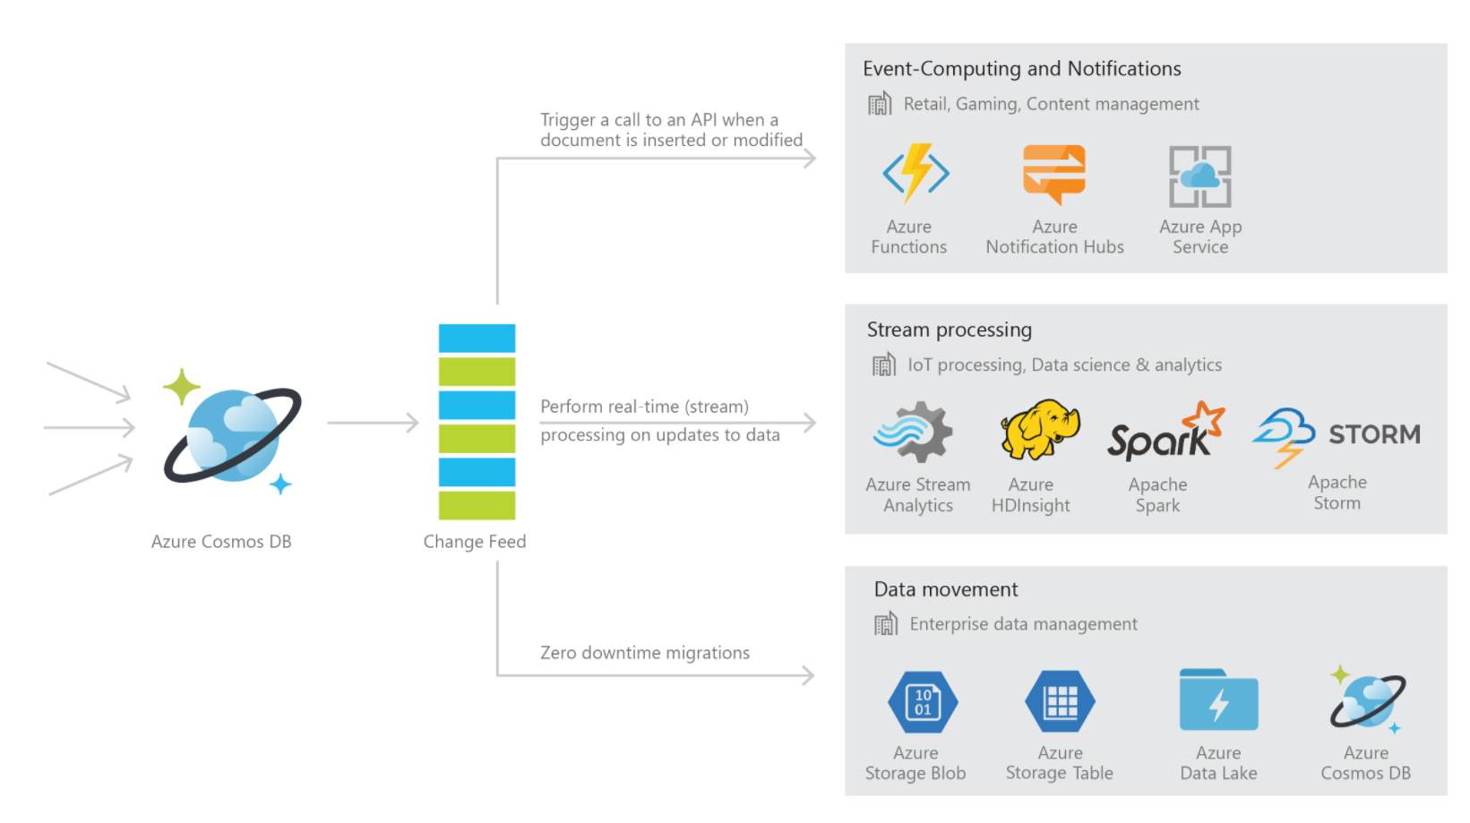
TTL and Change Feed
Common scenarios

Slide 83
Understand Table API
What we will cover
Introduction
SQL API vs. Table API.
Demo: Working with Table API.
Demo: Migrating data from Azure Table store to Table API or Azure Cosmos DB

Slide 84
Understand Table API
Introduction
Replaces Azure Table storage.
Implement a key-value data model
Key-value data model.
Key = PartitionKey + RowKey
Value = key-value pairs!
Leverage Cosmos DB back end.
Predictable throughput
Global distribution
Automatic indexing
Support of 5 consistency models.

Slide 85
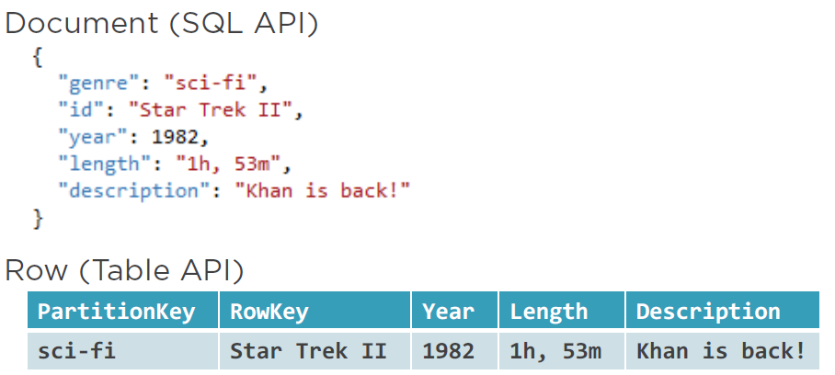
Understand Table API
SQL API vs. Table API
Cosmos DB | SQL API | Table API
Container | Collection | Table
Iteam | Document | Row
Partition Key | Any property | PartitionKey
ID | Id | RowKey

Slide 86
Understand and usage of Graph API
What we will cover
Introduction Graph API.
Vertices and Edges.
Comparison between 3 models.
Demo: Working with Graph DB.

Slide 87
Understand and usage of Graph API
Introduction Graph API.
Graph container.
Horizontal partitioning, provisioned throughput, global distribution, indexing
Vertex and Edge objects.
Entities and relationships
Both can hold arbitrary key-value pairs
Create/Retrieve/Update/Delete.
GraphSON and Gremlin
Apache TinkerPop (http://tinkerpop.apache.org)
Focus on relationships.
Chain relationship queries with Gremlin.
Vertex and Edge properties.
id (within partition key) label (type). Additional arbitrary properties (including the partition key).
Additional Edge properties.
Cardinality (in-and-out vertices) and Create two edges for bi-directionality

Slide 88
Understand and usage of Graph API
Vertices and Edges
Customer 1
[Vertex]
Label: Purchased [Edge]
inV: Customer 1
outV: Product A
Other properties
Label: Purchased [Edge]
inV: Customer 1
outV: Product B
Other properties
Product A
[Vertex]
Label: Product [Edge]
inV: Product A
Other properties
Product B
[Vertex]
Label: Product [Edge]
inV: Product B
Other properties
Label: Purchased [Edge]
inV: Customer 2
outV: Product A
Other properties
Customer 2
[Vertex]
Recommendation.

Slide 89
Understand and usage of Graph API
Writing Gremlin quries
Define Vertices and Edges.
.addV(‘label’)
.addE(‘label’)
.property(‘key’, ‘value’)
Query on filters and relationships
.V(‘label’)
.out(‘label’)
.has(‘property’,
condition)

Slide 90
Understand and usage of Graph API
Where it suites best
OLTP apps with highly correlated data.
Easy updates to single or many objects.
Flexible data modelling.
Data requirements that evolve.
Cheaper updates in relationships
Hierarchical data structures.
Typical graph applications.
Social networks
Recommendation engines
Knowledge graphs
Many more…

Slide 91
Understand and usage of Graph API
Sample HR Scenario
Sales
Group
Eng.
Group
Employee ID | Name | Group
1 | Luis Bosquez | Sales
2 | Rimma Nehme | Engineering
3 | Andrew Liu | Sales
Luis
Andrew
Rimma
3 rows, 3 columns
8 documents (vertices and edges)

Slide 92
Understand and usage of Graph API
Sample HR Scenario
Employee ID | Name
1 | Luis B.
2 | Rimma N.
3 | Andrew L.
FK Employee ID | FK Group ID
1 | 1
2 | 2
3 | 1
3 | 2
Sales
Group
Eng.
Group
member
Group ID | Name
1 | Sales
2 | Engineering
Luis
Andrew
Rimma
+ 2 tables, 6 rows, 4 new columns, -1 column alteration
+ 1 document

Slide 93
Understand and usage of Graph API
Azure
Sample HR Scenario
Employee ID | Name
1 | Luis B.
2 | Rimma N.
3 | Andrew L.
subgroups
FK Employee ID | FK Group ID
1 | 1
2 | 2
3 | 1
3 | 2
1 | 3
1 | 3
1 | 3
Sales
Group
Eng.
Group
Group ID | Name
1 | Sales
2 | Engineering
3 | Azure
FK Group ID | FK Nested Group ID
1 | 3
2 | 3
Luis
Andrew
Rimma
+ 3 documents
+ 1 tables, 6 rows, 2 new columns

Slide 94
Understand and usage of Graph API
Azure
Sample HR Scenario
Employee ID | Name
1 | Luis B.
2 | Rimma N.
3 | Andrew L.
FK Employee ID | FK Group ID
1 | 1
2 | 2
3 | 1
3 | 2
1 | 3
1 | 3
1 | 3
Sales
Group
Eng.
Group
Group ID | Name
1 | Sales
2 | Engineering
3 | Azure
FK Group ID | FK Nested Group ID
1 | 3
2 | 3
FK Employee ID | FK Report Employee ID
2 | 1
2 | 2
Luis
Andrew
Rimma
directReports
+ 1 table, 2 rows, 2 new columns
+ 2 documents

Slide 95
Understand and usage of Graph API
Azure
Sample HR Scenario
Employee ID | Name
1 | Luis B.
2 | Rimma N.
3 | Andrew L.
4 | New person
FK Employee ID | FK Group ID
1 | 1
2 | 2
3 | 1
3 | 2
1 | 3
1 | 3
1 | 3
4 | 2
4 | 3
Sales
Group
Eng.
Group
Group ID | Name
1 | Sales
2 | Engineering
3 | Azure
Luis
Andrew
Rimma
New Person
FK Group ID | FK Nested Group ID
1 | 3
2 | 3
FK Employee ID | FK Report Employee ID
2 | 1
2 | 2
2 | 4
directReports
+ 4 rows in 3 different tables
+ 3 documents

Slide 96
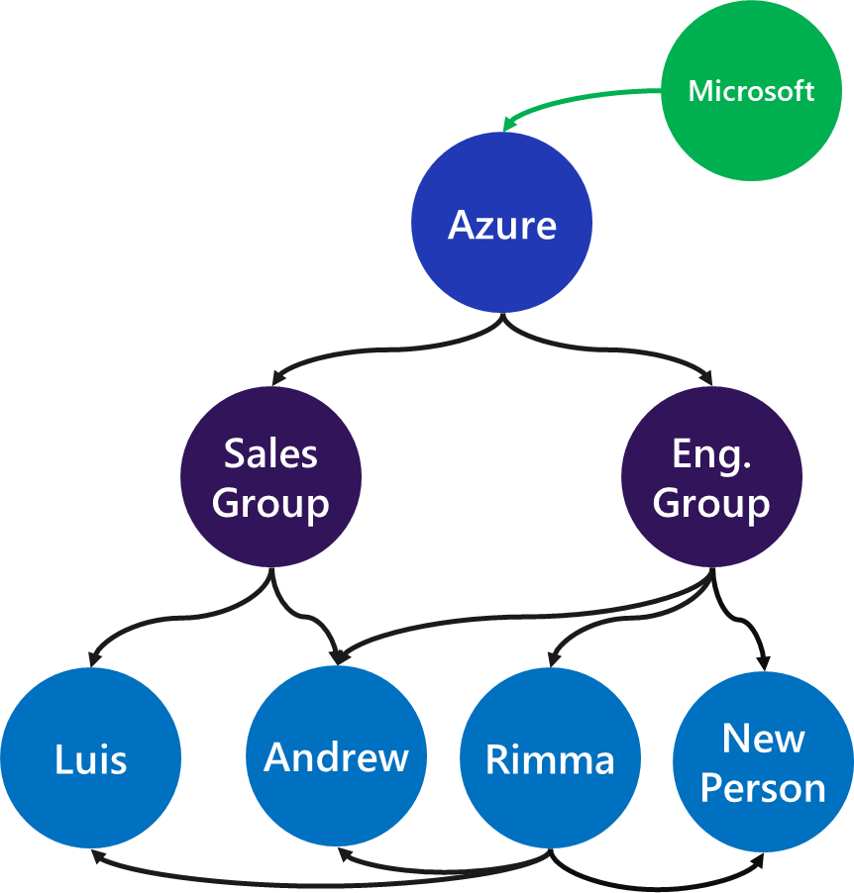
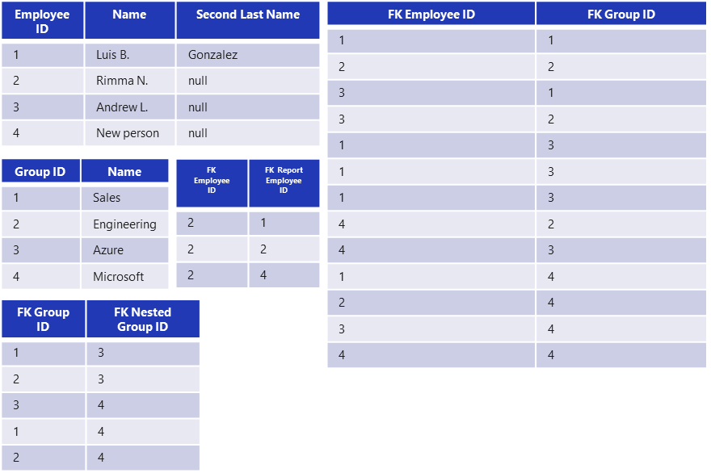
Understand and usage of Graph API
Sample HR Scenario
VS
SELECT name FROM Employee
INNER JOIN Employee_Group ON Employee_Group.EmployeeID = Employee.ID
INNER JOIN Groups ON Employee_Group.GroupID = Group.ID
INNER JOIN
(
SELECT DISTINCT EmployeeID FROM Employee_ReportEmployee
)
ON Employee_ReportEmployee.EmployeeID = Employee.ID
WHERE Group.Name = “Engineering”
g.V().has(‘id’, ‘Engineering’)
.out(‘members’)
.in(‘directReports’)
.values(‘name’)

Slide 97




Thank You
Nagesh Sathrasala
+91 9901788168
Nagesh.sathrasala@gmail.com

